Slide 1
NMAP
Team Pi

Slide 2
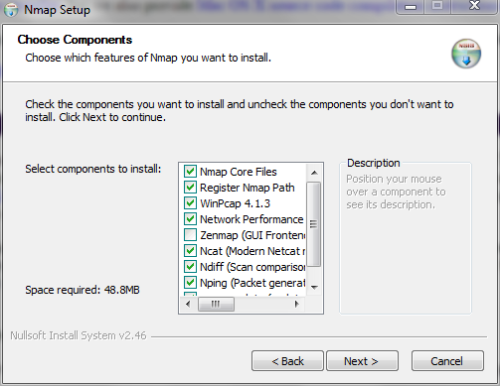
Install NMAP (Uncheck Zenmap)
Download the installer and run it. Uncheck Zenmap, which is a gui.

Slide 3
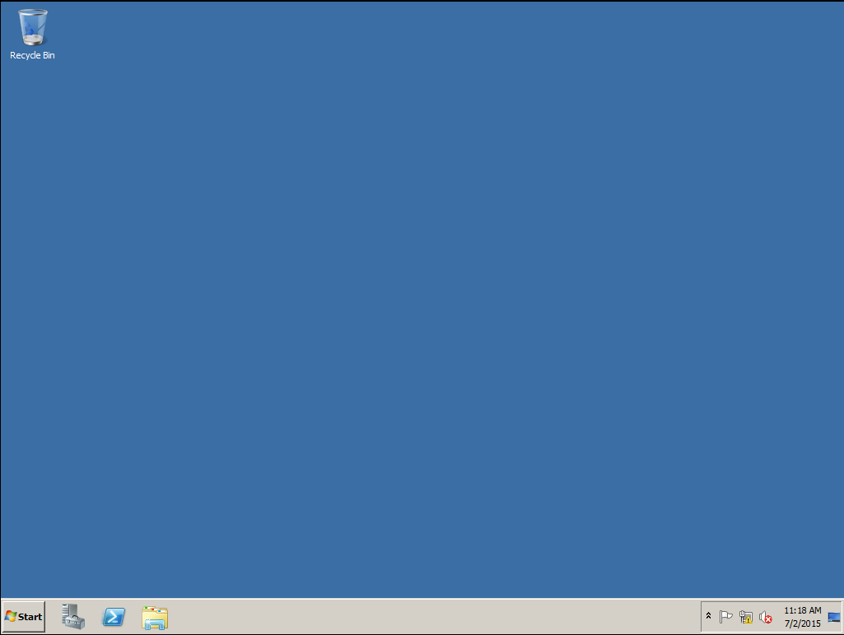
Turn on Windows Server 2008
Boot up a Windows Server 2008 in a VM.

Slide 4
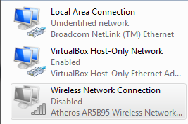
Turn off wireless and connect by enternet
Go to adapter setting and disable the wireless.

Slide 5
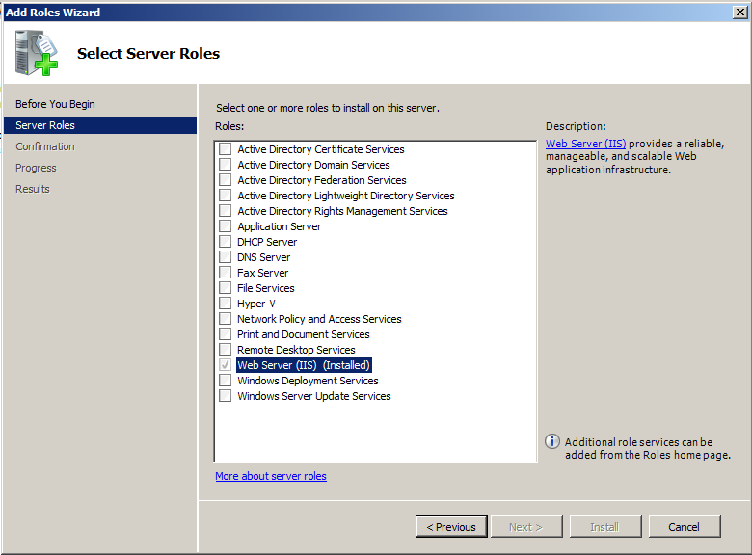
Install IIS, mail and FTP roles
Go through the wizards and install the features and roles.

Slide 6
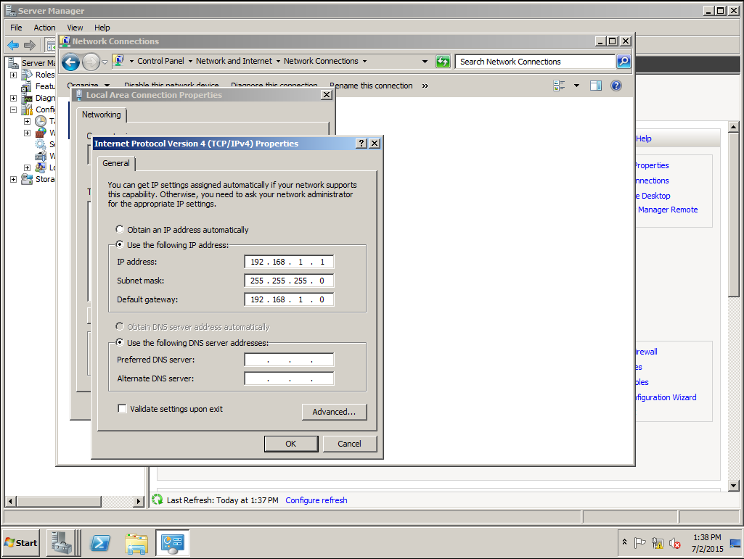
Give a static IP address to the server
In the adapter settings, go to properties then IPv4 and set IP and subnet mask.

Slide 7

Run a ping scan to check if the server is online
Use the command nmap -sn {IP} and it pings the host to see if it is online

Slide 8
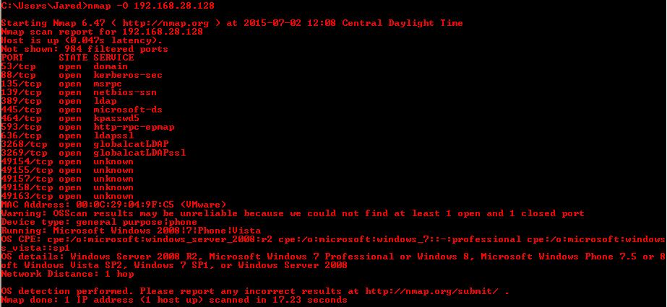
Scan the server to find it’s OS
Not very reliable but can help narrow down the OS

Slide 9
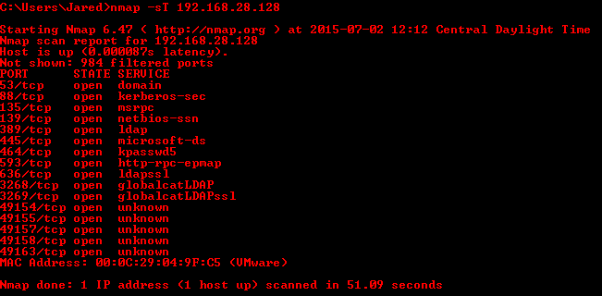
Run a TCP scan on the server and list the ports running on them
Useful for seeing which TCP ports are open and running

Slide 10

Run a stealth scan and find which ports are open
SYN or Stealth scanning makes use of this procedure by sending a SYN packet and looking at the response. If SYN/ACK is sent back, the port is open and the remote end is trying to open a TCP connection

Slide 11
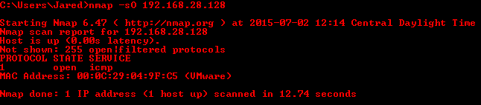
Run a protocol scan on the server
The IP Protocol Scans attempt to determine the IP protocols supported on a target

Slide 12
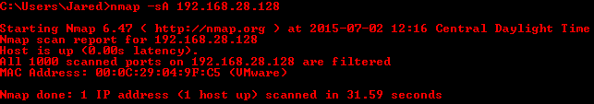
Run a scan to find if the firewall is stateful or stateless
Since all ports are filtered that means that the firewall is stateful

